Slide 1

VitalTracker
Smart Location Tracking Device
By Lifesaver Engineers
Group 10: Patrik Prenga (n01428752), Michael Carinci (n01480052), Jason Macdonald (n01246828), Nicholas Rafuse (n01440073)

Slide 2
Overview
Currently the Vital Tracker application aims to provide users with a comprehensive health and location monitoring system. The app is designed to enhance the safety and health monitoring of its users by tracking their vitals, location, and device status.

Slide 3
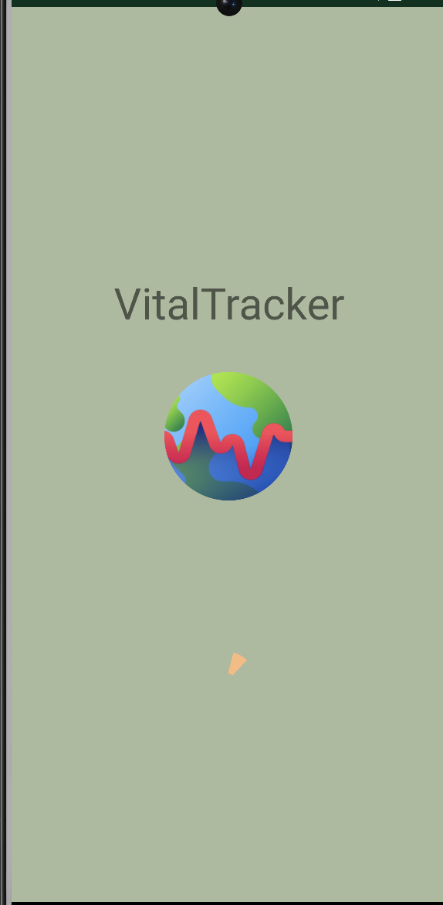
Splash Screen
Opens on app startup
Displays name, logo, progress bar
Runs for 3 seconds
Transitions to login screen

Slide 4
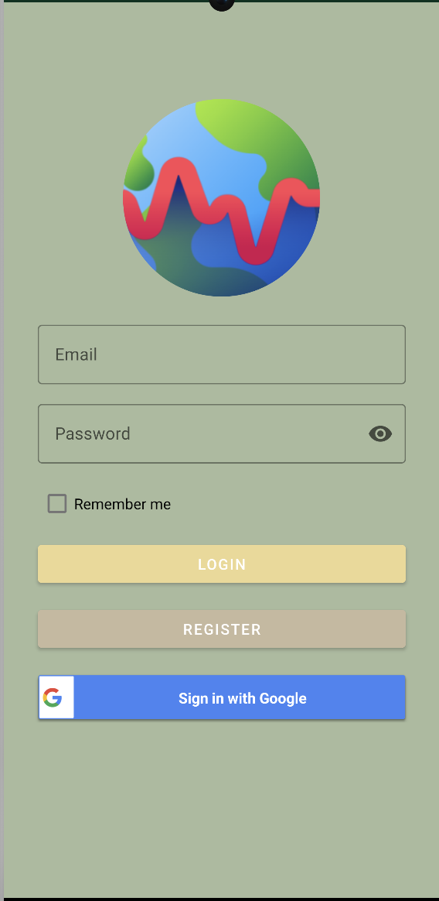
Login Screen
Immediately after splash screen, user must login to continue
User can create an account or sign in with google
User information is stored on the firebase database

Slide 5
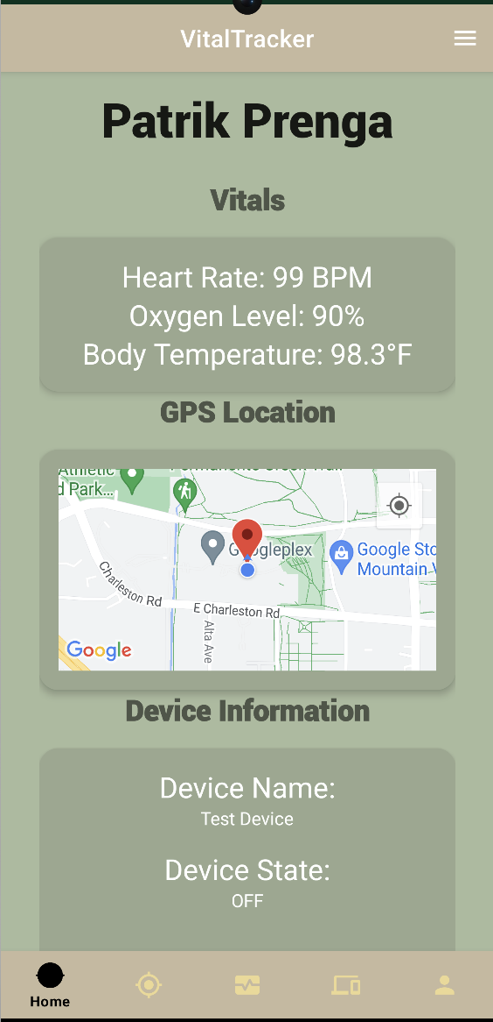
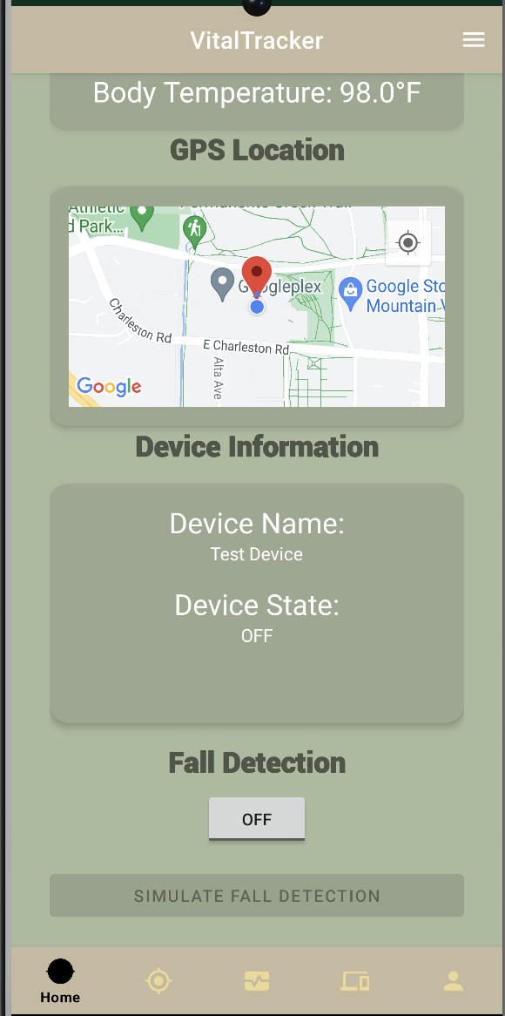
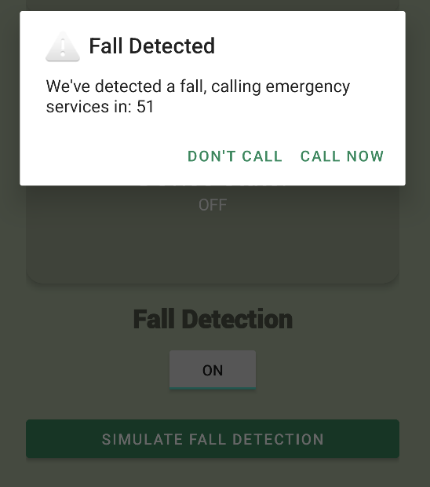
Home Screen
Main app screen
Shows quick visual screens for devices, current GPS location, vitals, and an optional fall detection feature
Displays username
All screens provide access to other screens using bottom navigation
The 3 containers are clickable and take you to there respective screen for more detail information

Slide 6
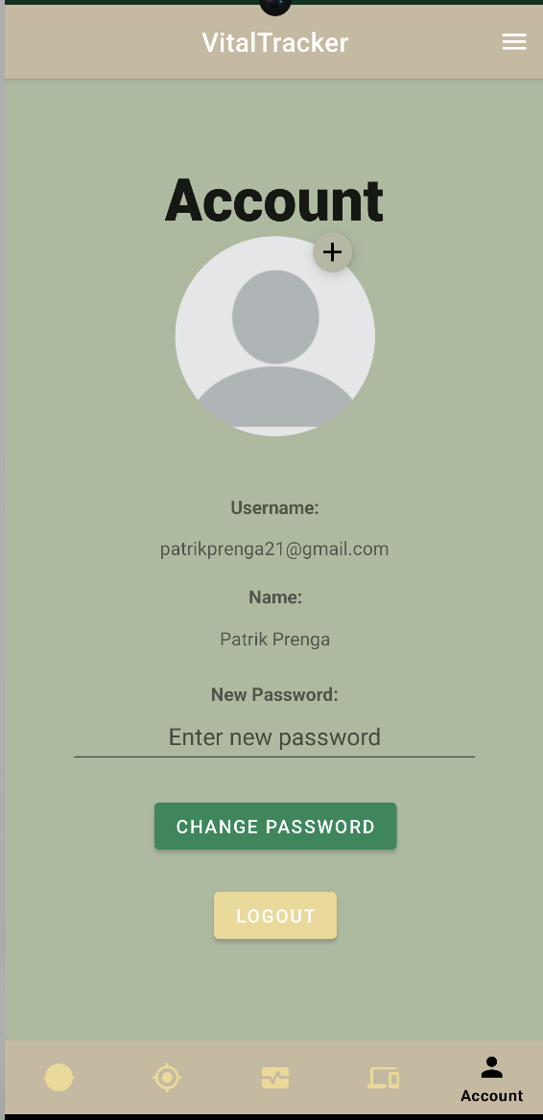
Account Screen
Shows User Profile Picture and allows user to change it
Displays account username and password in a hidden field
Allows user to change their current password
Equipped with a logout feature for when a user wants to logout

Slide 7
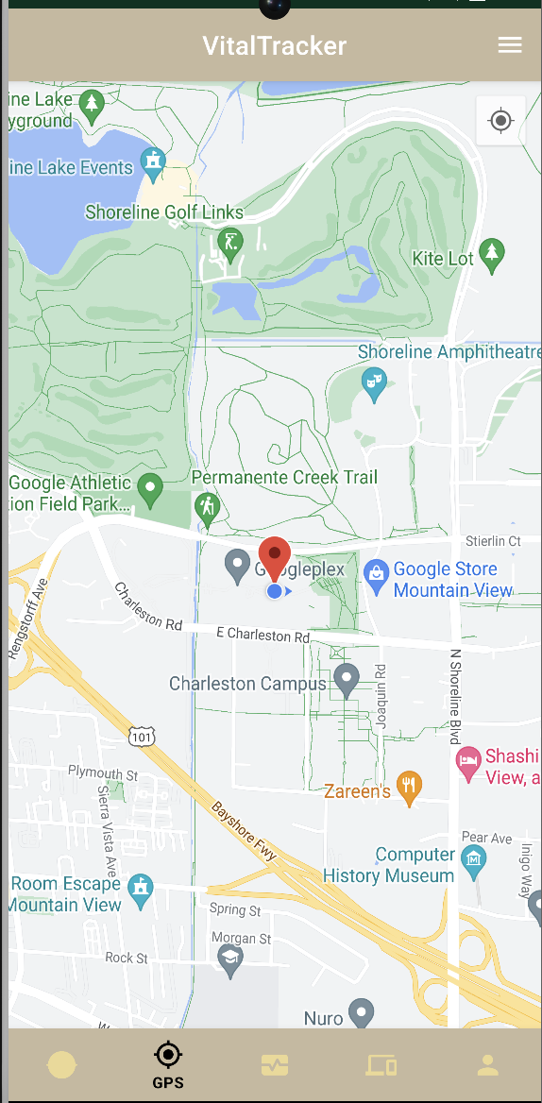
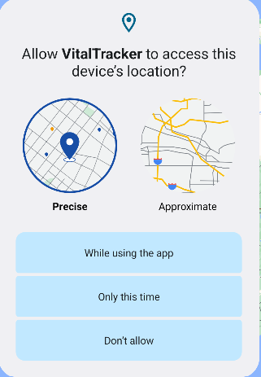
GPS Screen
Real time location of device
Live location updates
Requests runtime permission upon first usage

Slide 8
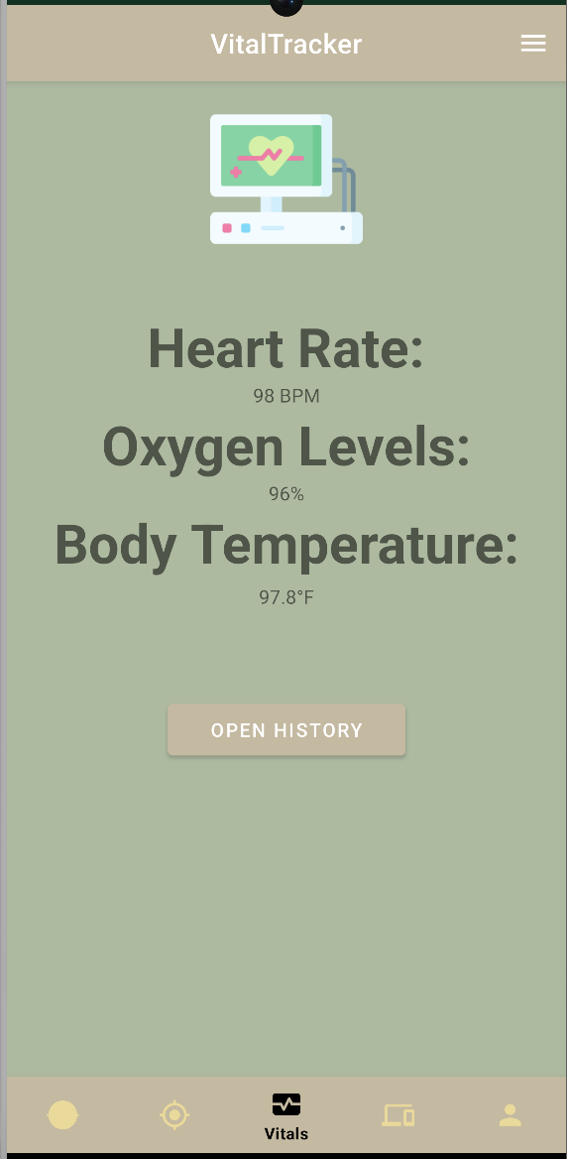
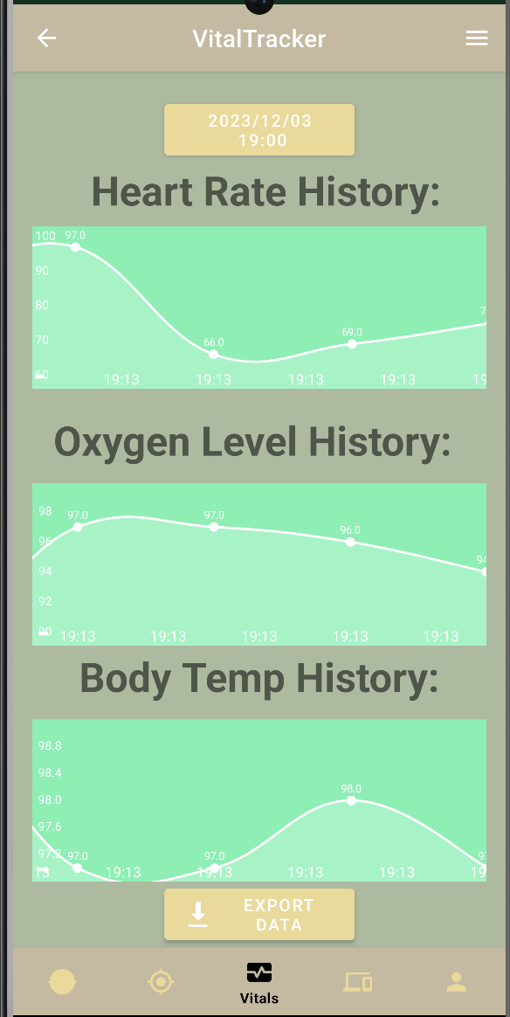
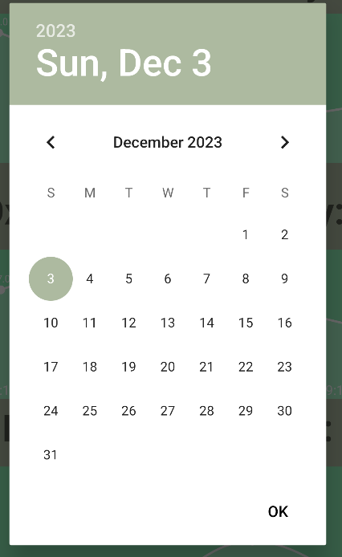
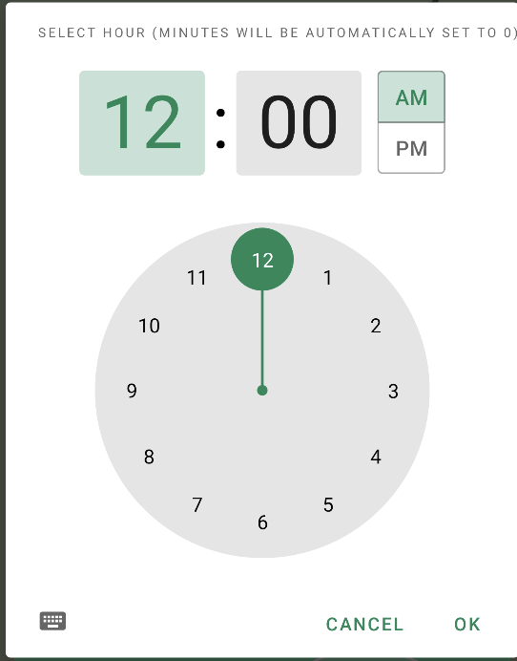
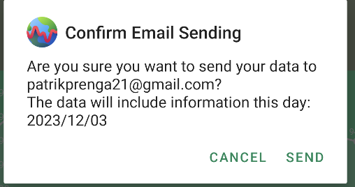
Vitals Screen
Continuous reading updates for heart rate, oxygen levels, and body temperature
Displays notifications for significant changes
Shows detailed history of vitals allowing the user to see their vitals from a certain day and time
Can export vitals data from the app into the users email

Slide 9
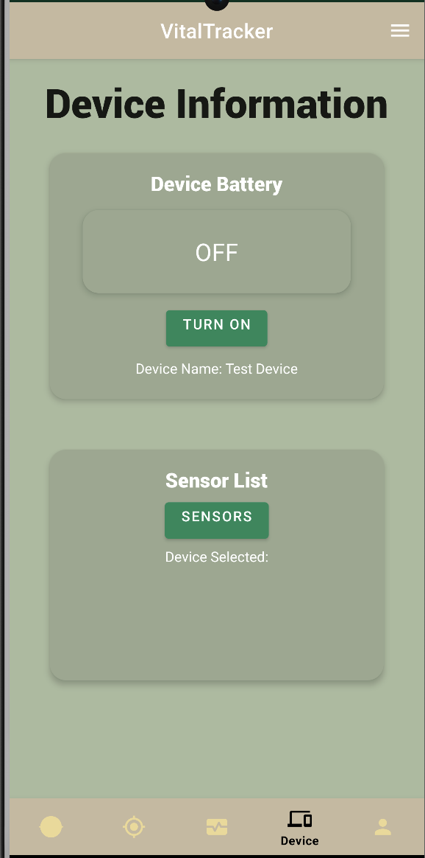
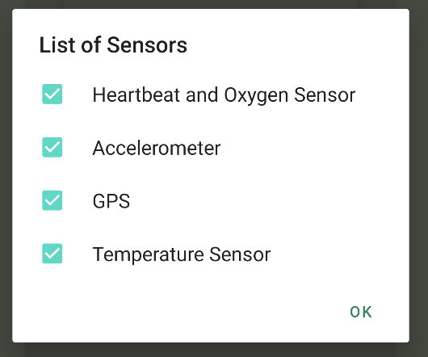
Device Screen
Displays all devices that are connected to the app
“Turn On” button to turn the device on
Displays device battery level
Displays the sensors in the device with a click of a button and allows user to turn on and off the sensors if they please

Slide 10
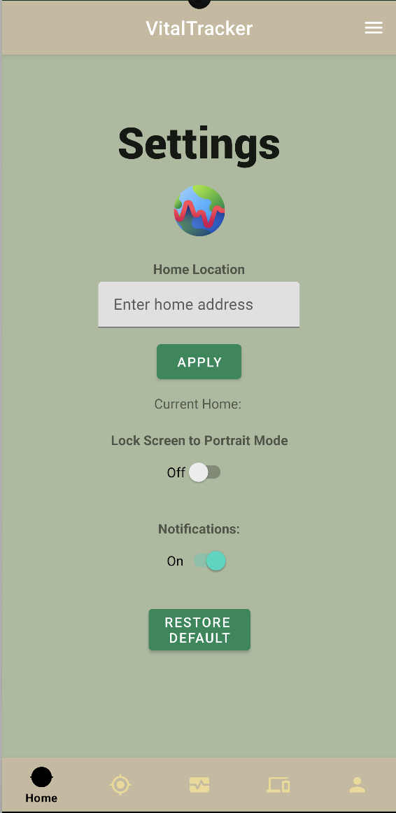
Settings Screen
Sets and displays GPS home location
Lock Display Orientation
Push Notifications Toggle Switch
Restore to Default button

Slide 11
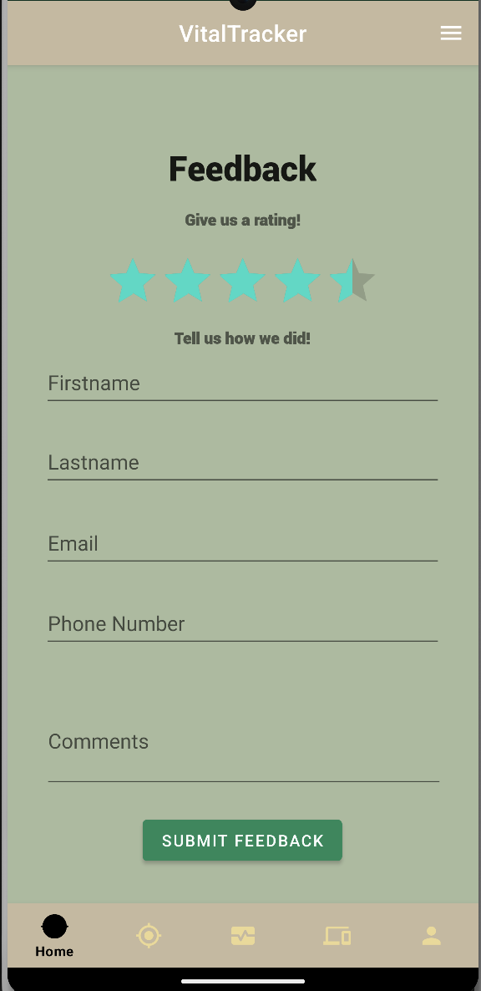
Feedback Screen
Has fields to allow users to enter their personal information in order to give feedback
Includes a 5 star grading system that can give out .5 stars

Slide 12
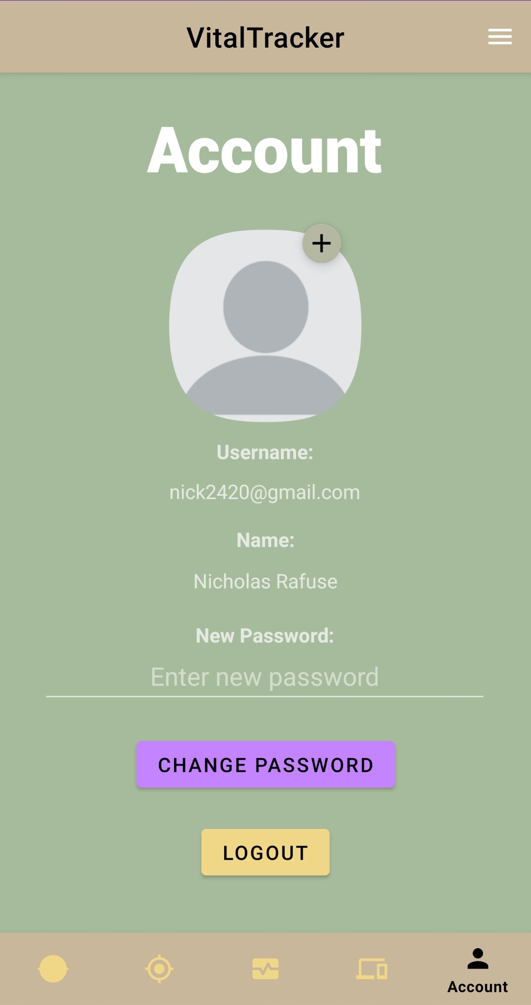
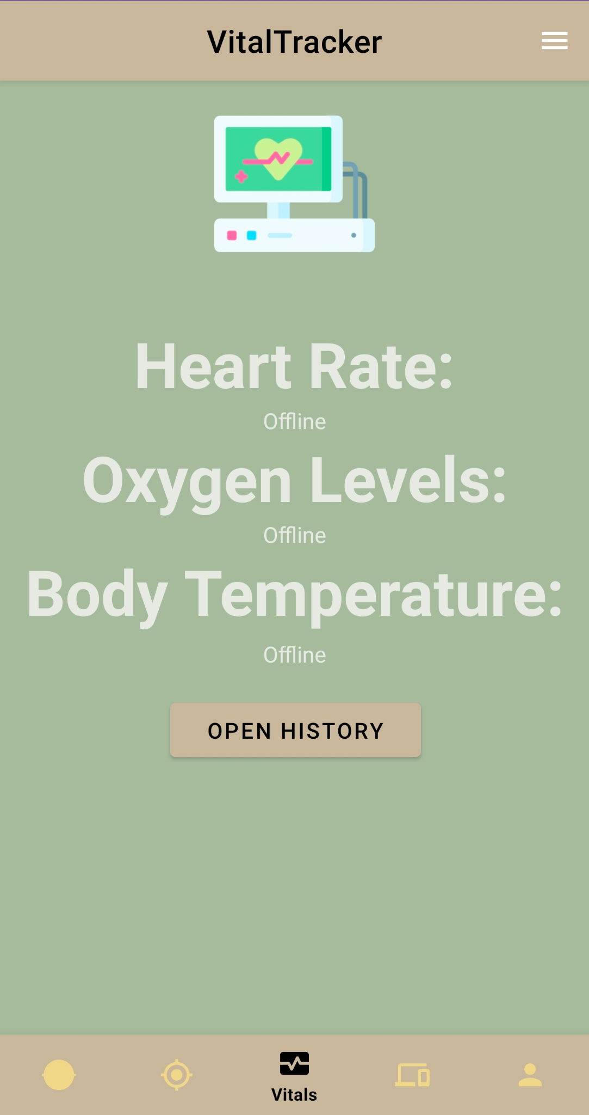
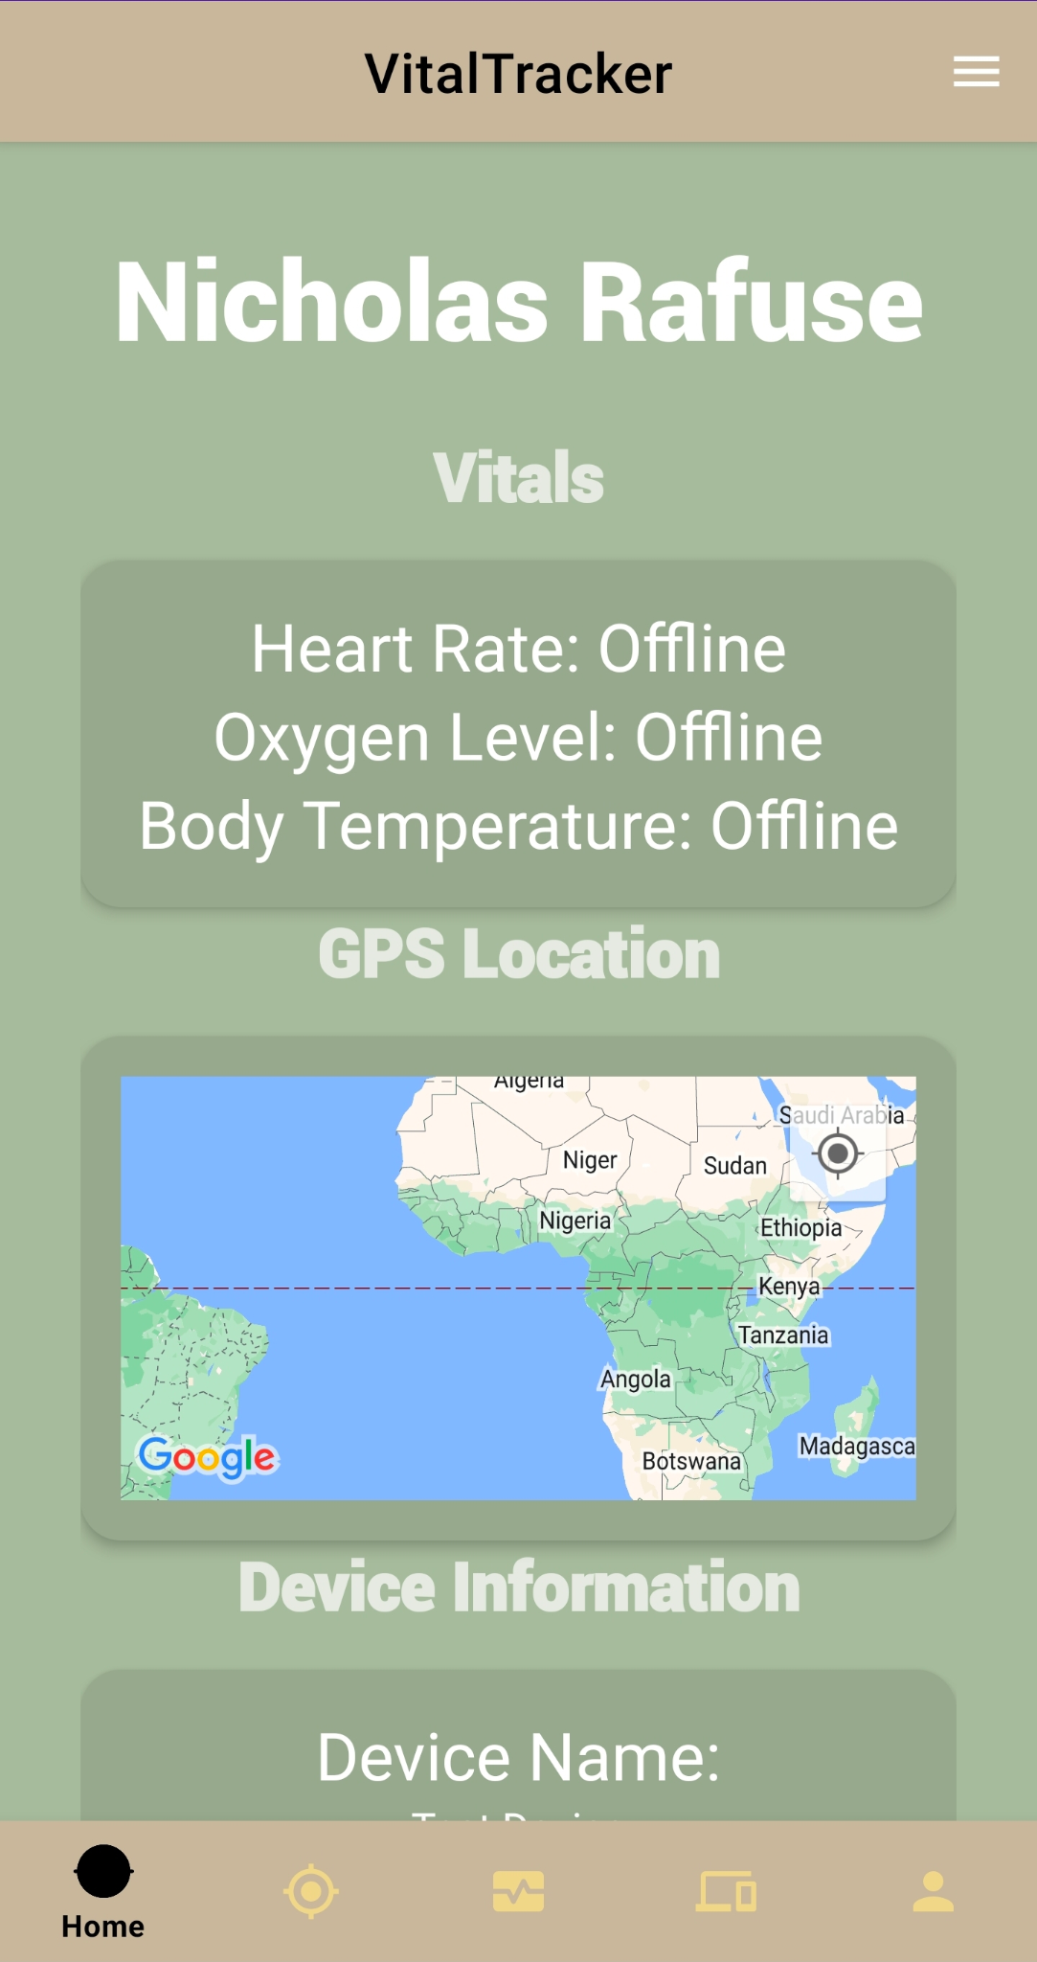
Offline mode

Slide 13
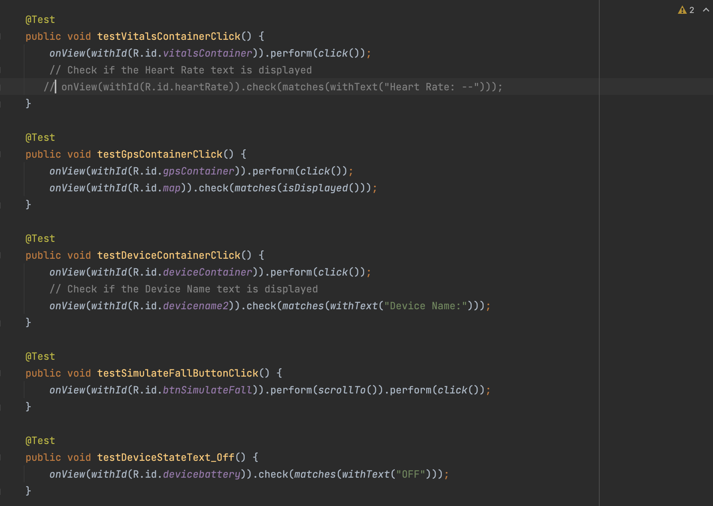
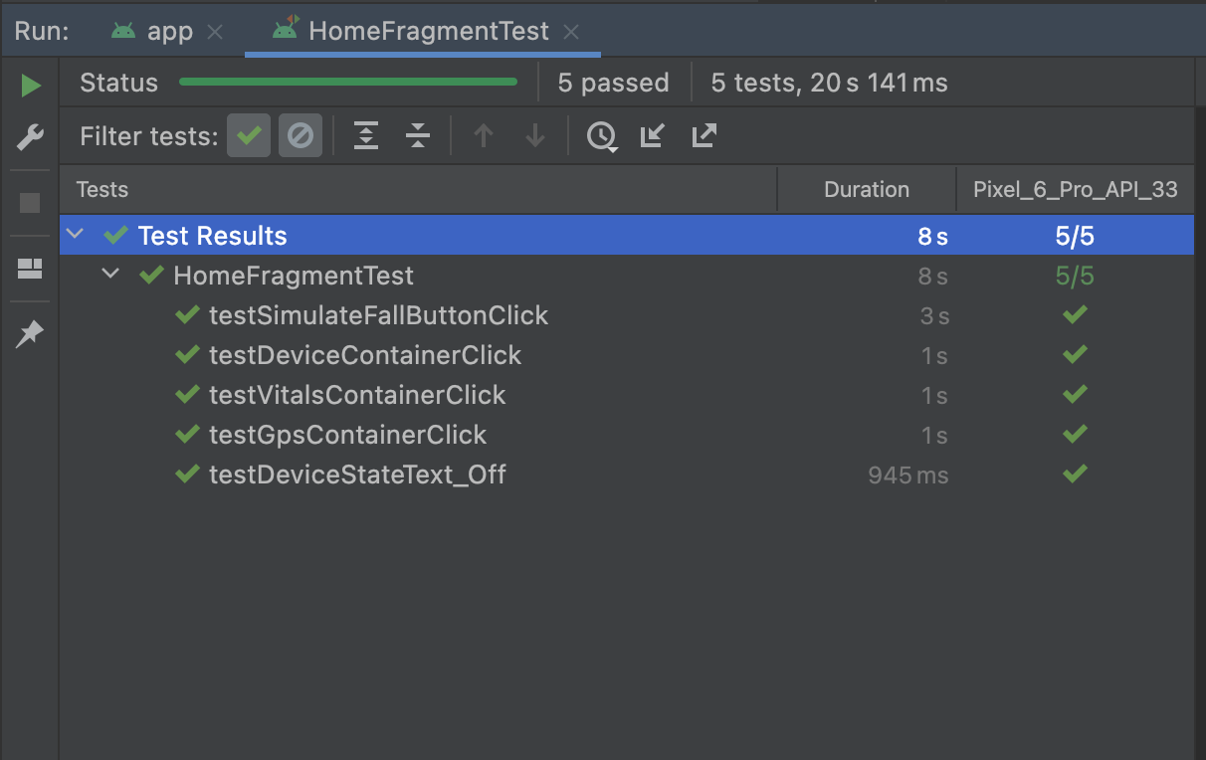
Test Cases
Espresso Testing

Slide 14
Sprint Dashboard
https://trello.com/w/workspace19208120

